Slide 1
Chapter 01 Introduction to Computer Vision
Prof. Lin ZHANG
School of Computer Science and Technology
Tongji University

Slide 2
Course Information
Contact Information
Room:
Email:
TA:
Course information can be found at
https://cslinzhang.github.io/home/CV/CV.htm

Slide 3
Materials
Major materials
My slides
References
张林，赵生捷，计算机视觉：原理算法与实践，清华大学出版社，2025年
Richard Hartley and Andrew Zisserman, Multiple View Geometry in Computer Vision (2nd Edition), Cambridge University Press, 2004
D.A. Forsyth and J. Ponce, Computer Vision: A Modern Approach (2nd Edition), Pearson Education, Inc., 2013

Slide 4
Examination
Homework 30%: 3 times, and each time 10%.
Project 20%: 2 or 3 people for one group
Final paper exam: 40%
Attendance: 10%; Being absent >=1/3 lectures, you will fail this course
Bonus 5%: being active in class and answering my questions correctly

Slide 5
Today
What is computer vision?
Why do we need to study CV?
Course overview

Slide 6
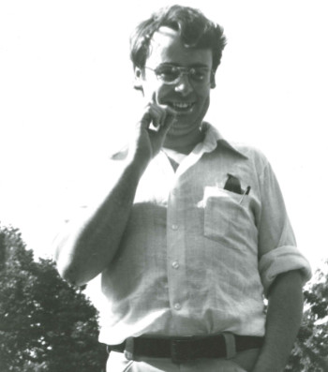
What is vision?
“The plain man’s answer (and Aristotle’s too) would be, to know what is where by looking. In other words, vision is the process of discovering from images what is present in the world, and where it is ” David Marr, Vision: A Computational Investigation into the Human Representation and Processing of Visual Information, 1982
David Marr (1945.1.19 – 1980.11.17), was a British neuroscientist and psychologist. The Marr Prize, one of the most prestigious awards in computer vision, is named in his honor.
Notes:
6
Clips: terminator 2, enemy of the state (from UCSD “Fact or Fiction” DVD)

Slide 7
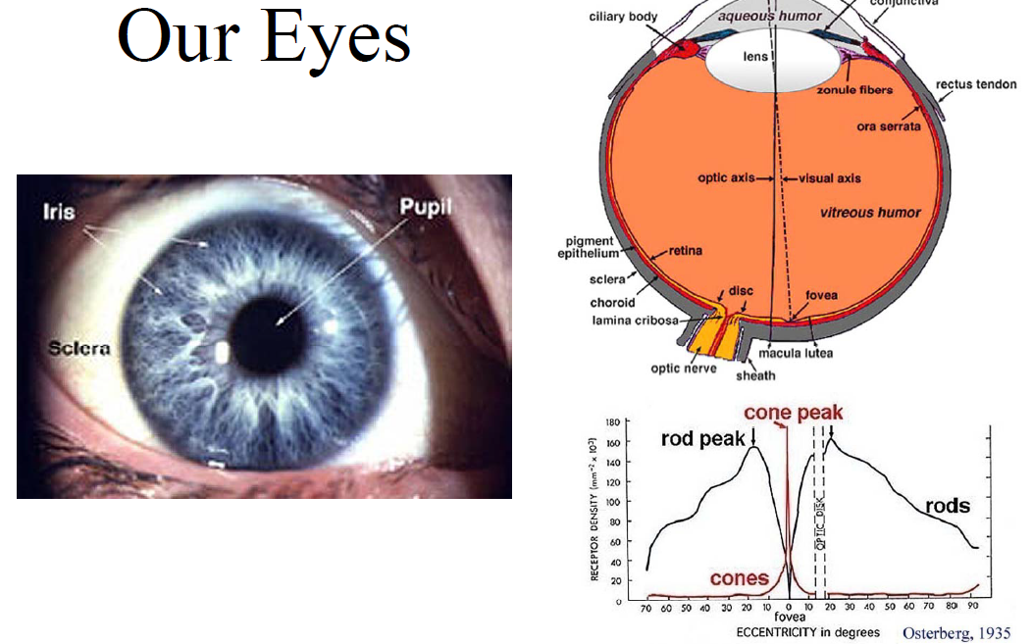
Human vision

Slide 8
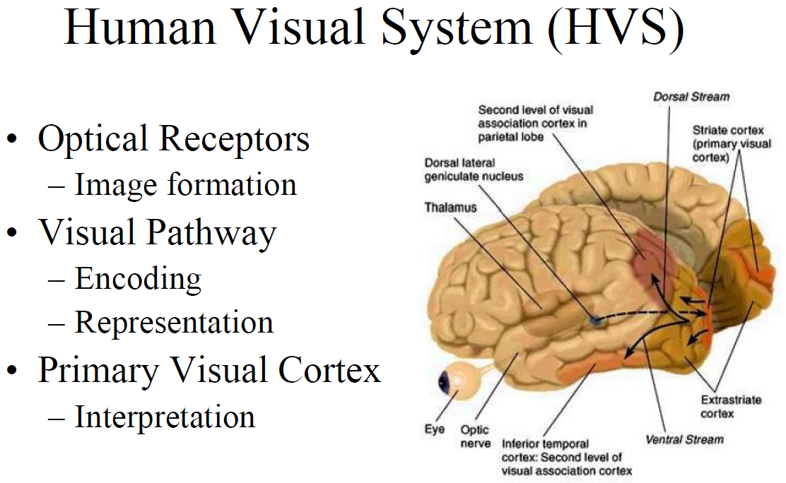
Human vision

Slide 9
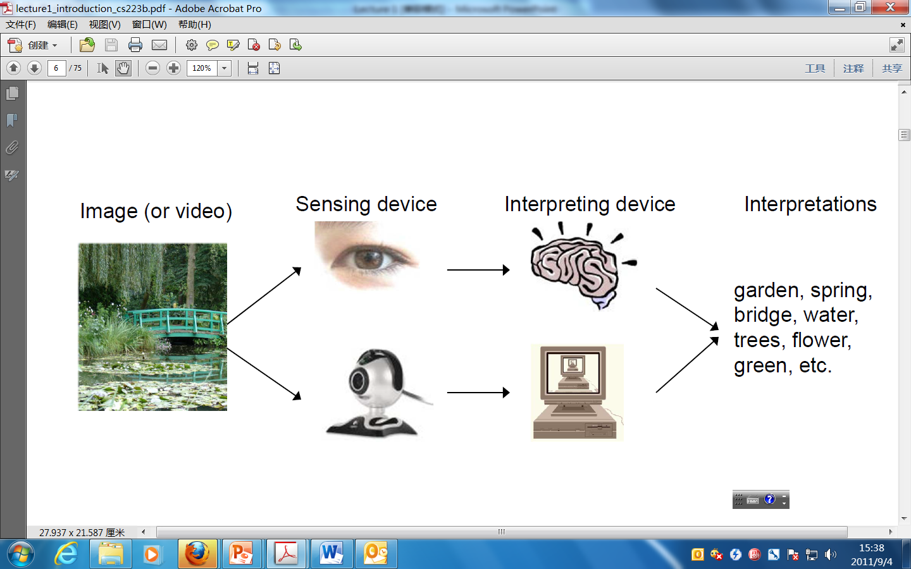
What is computer vision?

Slide 10
What is computer vision?
Computer Vision has a dual goal^{[1]}
From the biological science point of view, computer vision aims to come up with computational models of the human visual system
From the engineering point of view, computer vision aims to build autonomous systems which could perform some of the tasks which the human visual system can perform (and even surpass it in many cases) (our focus in this course!)
Of course, the two goals are intimately related. The properties and characteristics of the human visual system often give inspiration to engineers who are designing computer vision systems. Conversely, computer vision algorithms can offer insights into how the human visual system works
[1] T.S. Huang, “Computer vision: Evolution and promise,” Proc. 19th CERN School of Computing, Geneva: CERN, pp. 21-25, 1996.

Slide 11
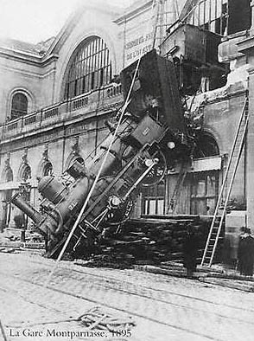
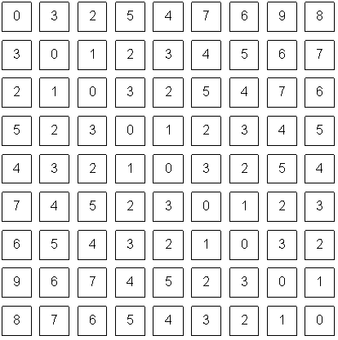
What is computer vision?
To bridge the gap between pixels and “meaning”
What we see
What a computer sees
Notes:
Clips: terminator 2, enemy of the state (from UCSD “Fact or Fiction” DVD)

Slide 12
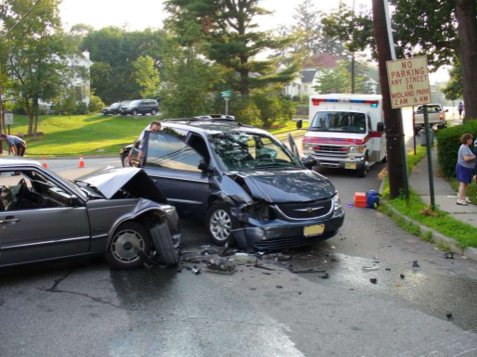
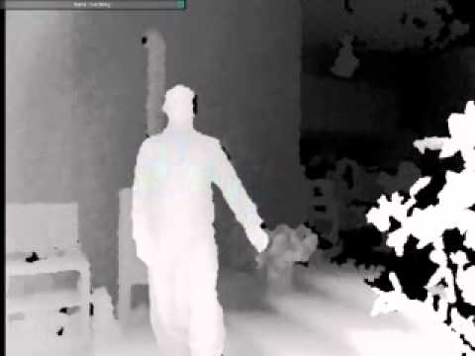
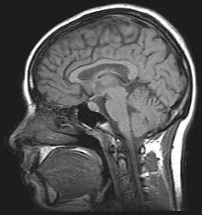
What is computer vision?
Computer vision is the science and technology of machines that can see
Concerned with the theory for building artificial systems that obtain information from images
The image data can take many forms, such as a video sequence, depth images, views from multiple cameras, or multi-dimensional data from a medical scanner
Notes:
12
Clips: terminator 2, enemy of the state (from UCSD “Fact or Fiction” DVD)

Slide 13
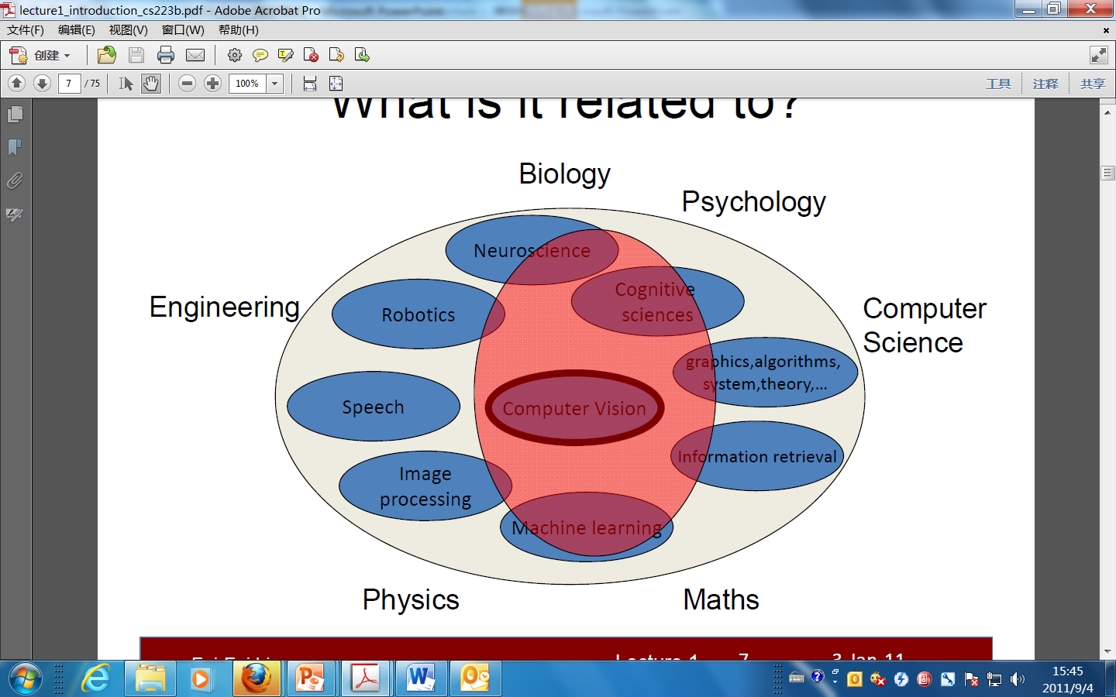
What is it related to?
Source: Feifei Li

Slide 14
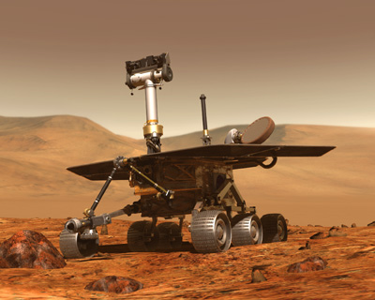
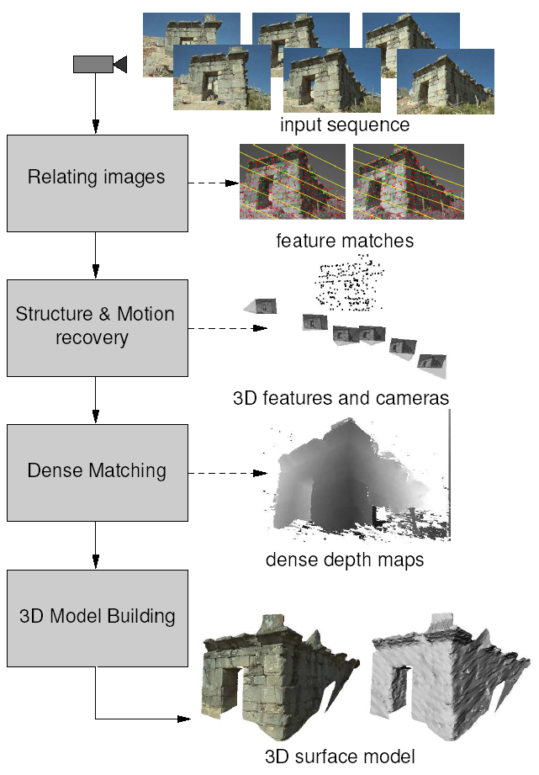

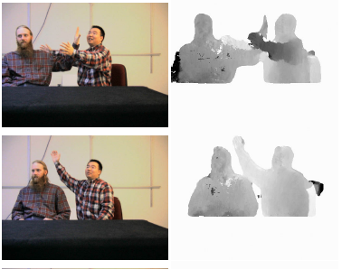
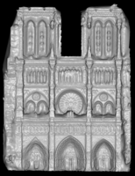
Vision as a measurement device
Reconstruction from Internet photo collections
Real-time stereo
Structure from motion
NASA Mars Rover
Pollefeys et al.
Goesele et al.

Slide 15

Vision as a measurement device
3D Reconstruction using RGB-D input (C. Guo, L. Zhang et al, ICASSP 2022)

Slide 16
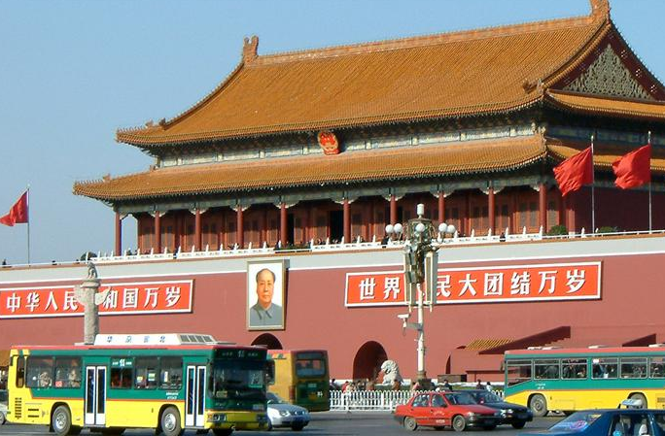
Vision as a source of semantic information
slide credit: Fei-Fei, Fergus & Torralba

Slide 17
Object categorization
sky
building
flag
face
banner
wall
street lamp
bus
bus
cars
slide credit: Fei-Fei, Fergus & Torralba

Slide 18
Scene and context categorization
outdoor
city
traffic
…
slide credit: Fei-Fei, Fergus & Torralba

Slide 19
A brief history about CV (in 1960s)
In 1963, Lawrence Roberts, a PhD student at the MIT, completed his thesis “Machine concept of three-dimensional solids”^{[2]}, which is considered as the first professional thesis in the field of computer vision; this thesis describes the process of deriving three-dimensional information from two-dimensional images in the ideal block world
In view of his groundbreaking contribution, Roberts is widely considered as the father of computer vision
Lawrence Gilman Roberts (December 21, 1937 to December 26, 2018), an American engineer, has completed the first doctoral thesis in the field of computer vision, and is generally considered as the father of computer vision; At the same time, he is also a pioneer in Internet technology. He and his team designed and managed the world's first packet switching network ARPANET.
[2] L. G. Roberts, Machine perception of three-dimensional solids, PhD thesis, Dept. of Electrical Engineering, Massachusetts Institute of Technology, 1963
Notes:
19
Clips: terminator 2, enemy of the state (from UCSD “Fact or Fiction” DVD)

Slide 20
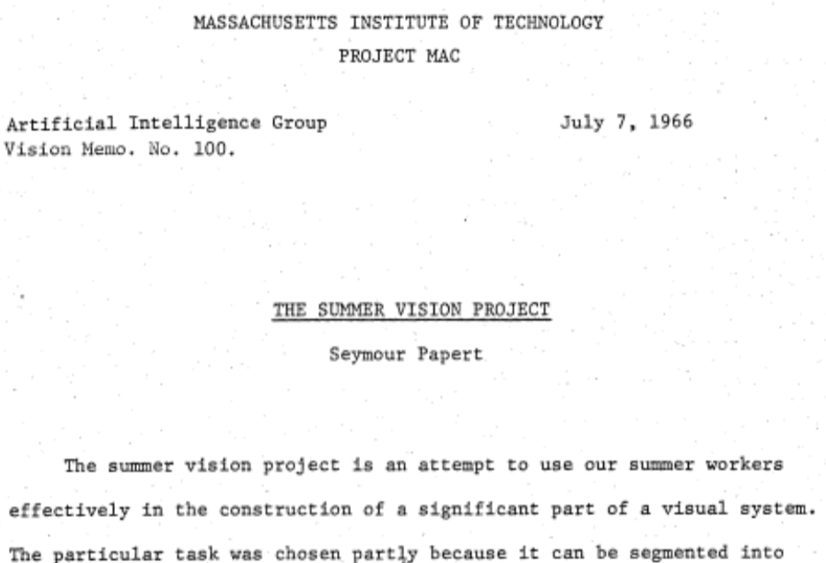
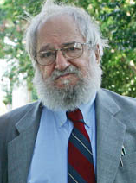
A brief history about CV (in 1960s)
In 1966, Seymour Papert at MIT asked his undergraduate student Gerald Jay Sussman to “spend the summer linking a camera to a computer and getting the computer to describe what it saw”
Seymour Aubrey Papert (Feb. 29, 1928~ Jul. 31, 2016) is an American mathematician, computer scientist and educator born in South Africa
Notes:
20
Clips: terminator 2, enemy of the state (from UCSD “Fact or Fiction” DVD)

Slide 21
A brief history about CV (in 1970s)
In the 1970s, there was a landmark work, the computational vision theory proposed by Professor David Marr of MIT
David Marr gave the development direction and some basic algorithms of computer vision from a rigorous and long-term perspective, providing a clear system for the research of this discipline
Marr described vision as proceeding from a two-dimensional visual array (on the retina) to a three-dimensional description of the world as output. His stages of vision include^{[3]}:
a primal sketch of the scene, based on feature extraction of fundamental components of the scene, including edges, regions, etc. Note the similarity in concept to a pencil sketch drawn quickly by an artist as an impression.
a 2.5D sketch of the scene, where textures are acknowledged, etc. Note the similarity in concept to the stage in drawing where an artist highlights or shades areas of a scene, to provide depth
a 3D model, where the scene is visualized in a continuous, 3-dimensional map.
[3] David Marr, Vision: A Computational Investigation into the Human Representation and Processing of Visual Information, W. H. Freeman and Company, 1982
Notes:
21
Clips: terminator 2, enemy of the state (from UCSD “Fact or Fiction” DVD)

Slide 22


A brief history about CV (in 1980s)
In 1989, Yann LeCun invented the convolutional neural network and applied it to hand-written digits recognition
29 years later, He was awarded ACM Turing Award in 2018
Yann LeCun, July 8, 1960~, a French computer scientist, is currently a professor at New York University
A demo from 1993 of 33-year-old Yann LeCun showing off the world's first convolutional network for text recognition
Notes:
22
Clips: terminator 2, enemy of the state (from UCSD “Fact or Fiction” DVD)

Slide 23


A brief history about CV (in 1980s)
CVPR (IEEE International Conference on Computer Vision and Patter Recognition) was founded in 1983
ICCV (IEEE International Conference on Computer Vision) was founded in 1987
Notes:
23
Clips: terminator 2, enemy of the state (from UCSD “Fact or Fiction” DVD)

Slide 24
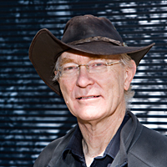
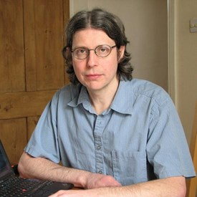
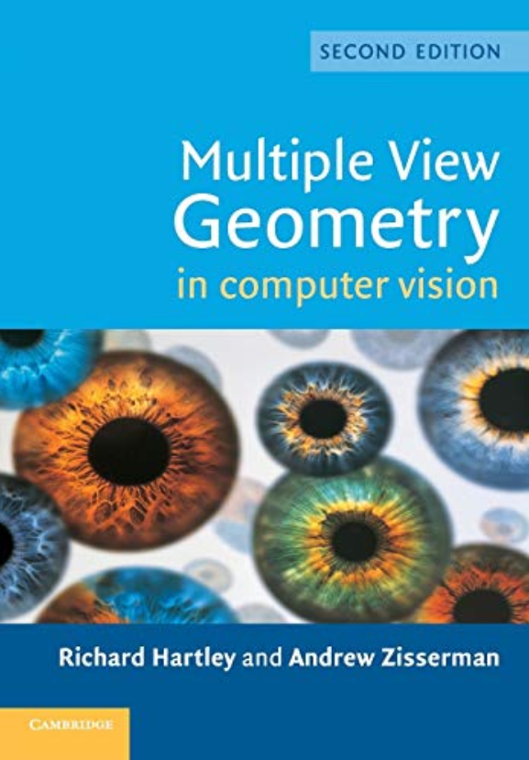
A brief history about CV (from 1990 to and 2010)
In 1999, David Lowe invented SIFT (scale invariant feature transform)
In 1999, Zhengyou Zhang, a Chinese researcher in Microsoft, invented the camara calibration algorithm using planar calibration patterns
In 2001, Paul Viola and Michael Johns invented Adaboost+Haar features based real-time face detection algorithm
In 2000, Richard Hartley (University of Queensland, Australia) and Andrew Zisserman (Oxford University, Britain) published their famous textbook “Multiple View Geometry in Computer Vision”
Richard, Andrew, and their famous book
Notes:
24
Clips: terminator 2, enemy of the state (from UCSD “Fact or Fiction” DVD)

Slide 25

A brief history about CV (from 1990 to and 2010)
In 2009, Li Fei-fei (Stanford University, USA) released the ImageNet dataset which is a large-scale dataset for benchmarking image classification and object detection algorithms
Li Fei-Fei, a professor of Stanford University. Li was born in Beijing, China in 1976 and grew up in Chengdu. When she was 12, her father moved to the US; when she was 15, she and her mother joined him in Parsippany-Troy Hills, New Jersey. Dr. Li is an elected Member of the National Academy of Engineering (NAE), USA
Notes:
25
Clips: terminator 2, enemy of the state (from UCSD “Fact or Fiction” DVD)

Slide 26
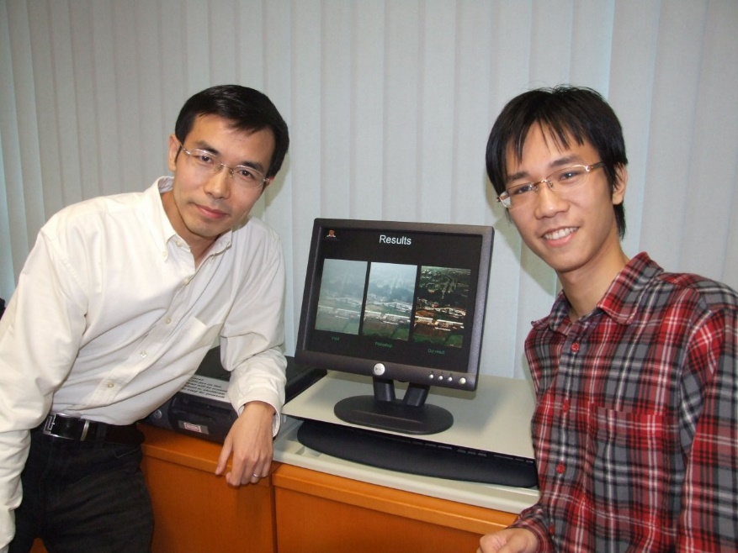

A brief history about CV (Since 2010s)
In 2012, Alex Krizhevsky (Toronto University, Canada) et al. built the first deep CNN and won the ILSVRC challenge of that year. The year 2012 has been deemed as the starting year of the deep learning era
In 2016, Kaiming He, Jian Sun et al. invented the ResNet, which is now the basic module of almost all the modern network architectures
Xiaoou Tang and Kaiming He, in CUHK, 2009
Kaiming joined EECS, MIT as a faculty member in 2024
Notes:
26
Clips: terminator 2, enemy of the state (from UCSD “Fact or Fiction” DVD)

Slide 27
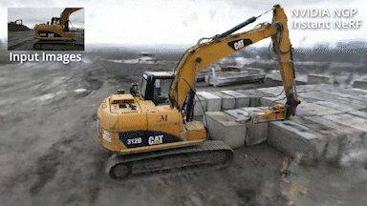
A brief history about CV (Since 2010s)
In 2014, Ian Goodfellow (Montreal University, Canada) et al. proposed Generative Adversarial Networks, which is now widely used for self-supervised learning
In 2020, Ben Mildenhall (University of California, Berkeley, USA) et al. proposed NeRF (Neural radiance field) based rendering, which is now a new paradigm for image based reconstruction and rendering
Notes:
27
Clips: terminator 2, enemy of the state (from UCSD “Fact or Fiction” DVD)

Slide 28
Today
What is computer vision?
Why do we need to study CV?
Course overview

Slide 29
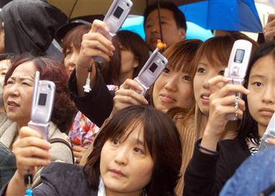
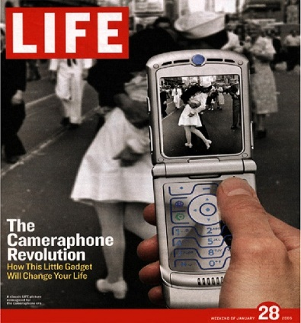
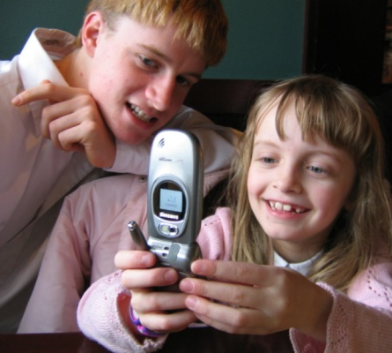
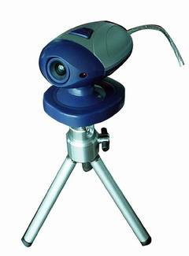
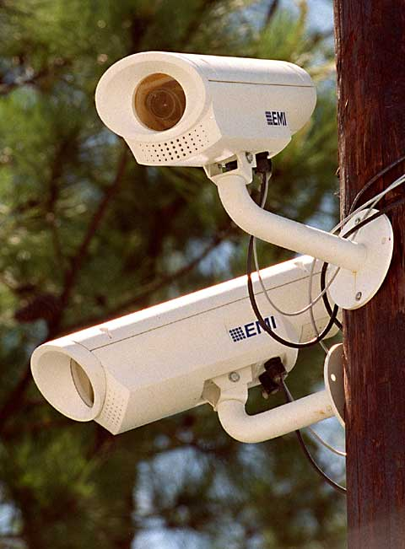
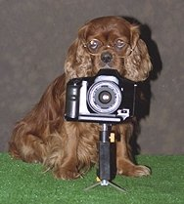
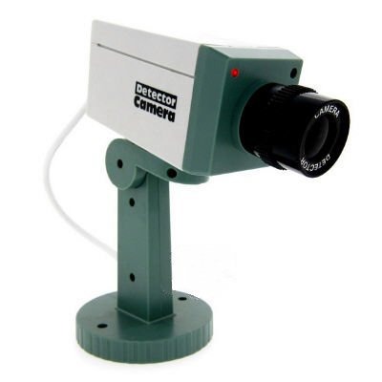
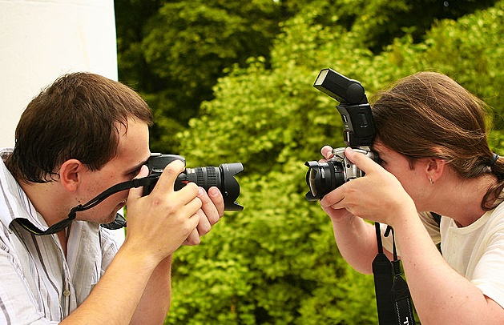
Why study computer vision?

Slide 30


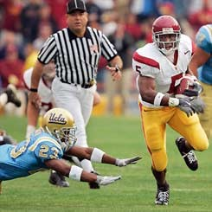

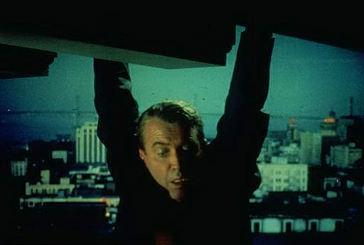


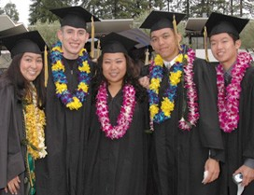
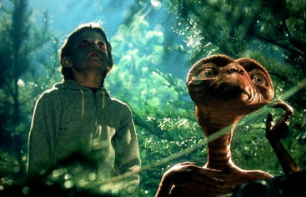


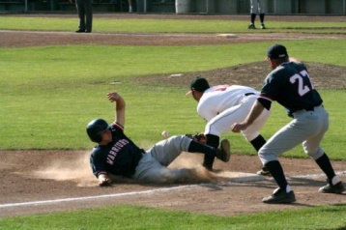






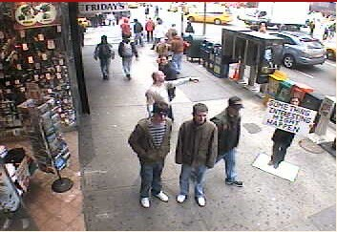
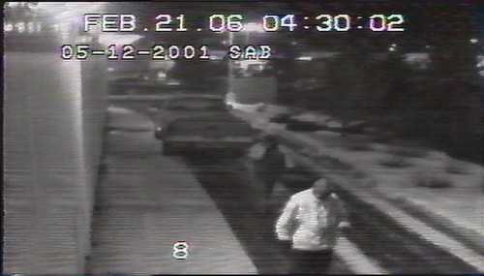
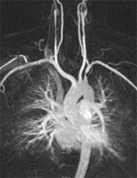
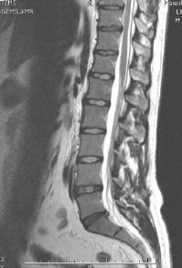
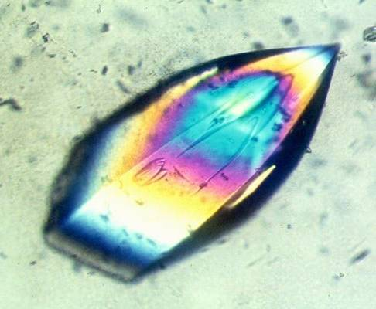
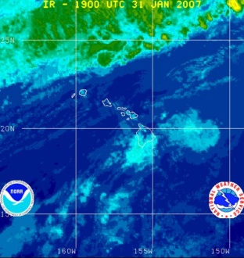

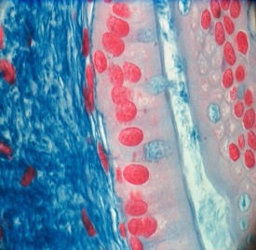
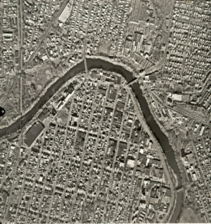
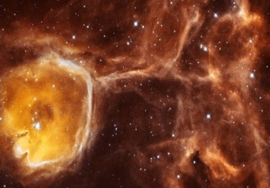
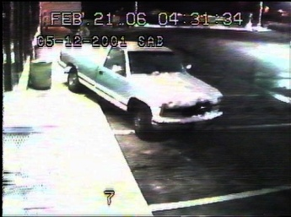
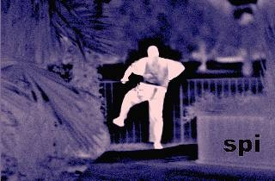
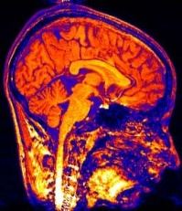
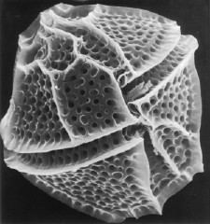
Why study computer vision?
Vision is useful: Images and video are everywhere!
Personal photo albums
Movies, news, sports
Surveillance and security
Medical and scientific images

Slide 31
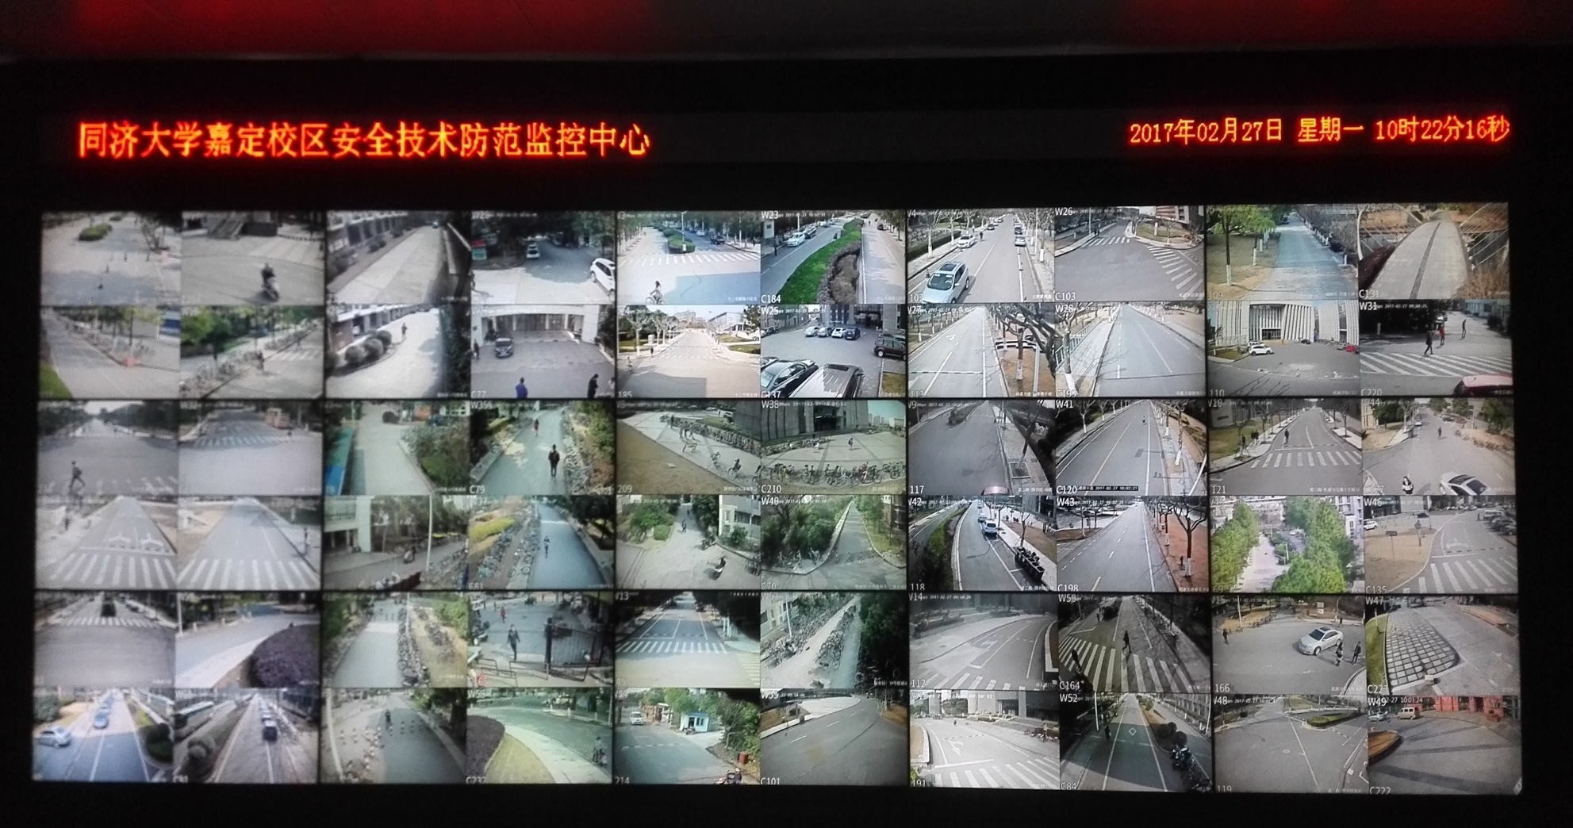
Why study computer vision?
Vision is useful: Images and video are everywhere!

Slide 32
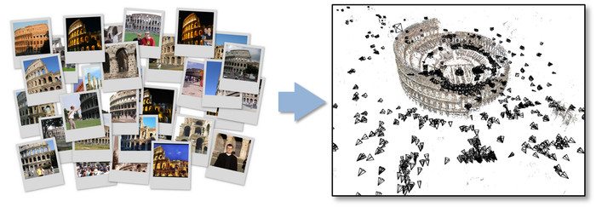
Structure from motion
Bundler: Structure from Motion (SfM) for Unordered Image Collections (https://www.cs.cornell.edu/~snavely/bundler/#S3)

Slide 33

Automotive safety
ApolloScape Open Dataset for Autonomous Driving^{[1]}
holistic semantic dense point cloud for each site
Stereo
per-pixel semantic labelling
lanemark labelling
instance segmentation
3D car instance
high accurate location for every frame in various driving videos
[4] X. Huang et al., The ApolloScape Open Dataset for Autonomous Driving and Its Application, IEEE T-PAMI, vol. 42, pp. 2702-2719, Oct. 2020

Slide 34
AVP (Automated Valet Parking)
2021年4月，威马W6车型已量产百度AVP系统

Slide 35


Optical character recognition (OCR)
Technology to convert scanned docs to text
If you have a scanner, it probably came with OCR software
Digit recognition, AT&T labs
http://www.research.att.com/~yann/
License plate readers
http://en.wikipedia.org/wiki/Automatic_number_plate_recognition

Slide 36

Videos based applications

Slide 37

Face and mask detection
https://www.bilibili.com/video/av926885838?p=15
Notes:
Why would this be useful? Main reason is focus. Also enables “smart” cropping.

Slide 38





Vision-based biometrics
“How the Afghan Girl was Identified by Her Iris Patterns”

Slide 39
Robotics
Robotics in MAP (Machine Autonomous Perception) lab

Slide 40
Work by our students: Photosynth
Project products of students from 2009 Media&Arts

Slide 41



Recent work of our group
Palmprint and palmvein recognition
Lin Zhang, Lida Li, Anqi Yang et al., "Towards contactless palmprint Recognition: A novel device, a new benchmark, and a collaborative representation based identification approach", Pattern Recognition, vol. 69, pp. 199-212, 2017

Slide 42
Recent work of our group
Palmprint verification on mobilephones
Yingyi Zhang, Lin Zhang* et al., Pay by showing your palm: A study of palmprint verification on mobile platforms, in: Proc. ICME, pp. 862-867, 2019.

Slide 43


Recent work of our group
图像曝光度的自动校正

Slide 44


Recent work of our group
图像曝光度的自动校正

Slide 45
Recent work of our group
4
图像曝光度的自动校正
Lin Zhang, Lijun Zhang et al., "Zero-Shot Restoration of Back-lit Images Using Deep Internal Learning", ACM Int'l Conf. Multimedia, 2019

Slide 46
Recent work of our group
Simulation of atmospheric visibility impairment
Lin Zhang, Anqi Zhu, Shiyu Zhao et al., "Simulation of atmospheric visibility impairment", IEEE Trans. Image Processing, vol. 30, pp. 8713-8726, 2021.

Slide 47
Recent work of our group
Short-range Self-parking
Lin Zhang, Junhao Huang et al., "Vision-based parking-slot detection: A DCNN-based approach and a large-scale benchmark dataset", IEEE Trans. Image Processing, vol. 27, no. 11, pp. 5350-5364, 2018.

Slide 48

Recent work of our group

Slide 49
Recent work of our group
Pedestrian and speed-bump detection and distance measurement

Slide 50
Recent work of our group
Online optimization of camera poses in a surround-view system
Tianjun Zhang, Lin Zhang* et al., "ROECS: A Robust Semi-direct Pipeline Towards Online Extrinsics Correction of the Surround-view System", in Proc. ACM Int'l Conf. Multimedia, 2021.

Slide 51
Recent work of our group
Photometric adjustment in the surround-view

Slide 52
Recent work of our group
SLAM for indoor parking environments
Xuan Shao, Lin Zhang* et al., "MOFIS_{SLAM}: A multi-object semantic SLAM system with front-view, inertial and surround-view sensors for indoor parking", IEEE Trans. CSVT, 2022

Slide 53
Recent work of our group
Panoramic video stitching
Anqi Zhu, Lin Zhang* et al, Pedestrian-Aware Panoramic Video Stitching Based on a Structured Camera Array, ACM Transactions on Multimedia Computing, Communications, and Applications, 17 (4): 136, 2021.

Slide 54
Recent work of our group
Multi-agent mapping
Tianjun Zhang, Lin Zhang* et al., "CVIDS: A collaborative localization and dense mapping framework for multi-agent based visual-inertial SLAM," IEEE Transactions on Image Processing, vol. 31, 2022

Slide 55
Recent work of our group
Tightly-coupled direct LiDAR-inertial odometry and mapping
Zhong Wang, Lin Zhang* et al., "D-LIOM: Tightly-coupled direct LiDAR-inertial odometry and mapping," IEEE Transactions on Multimedia, 2023

Slide 56
Recent work of our group
Sound localization in noisy environments
Zhanbo Shi, Lin Zhang* et al., Audio–Visual Sound Source Localization and Tracking Based on Mobile Robot for The Cocktail Party Problem, Appl. Sci., 13(10), 2023

Slide 57
Recent work of our group
Human pose tracking using sparse IMUs
Kaixin Chen, Lin Zhang* et al., "Skeleton-aware Graph-based Adversarial Networks for Human Pose Estimation from Sparse IMUs," ACM Transactions on Multimedia Computing, Communications, and Applications, 2024.

Slide 58
You can find a good job!
Many first-class companies now are developing CV related applications, to name a few
ByteDance
Google
Ali
Meta
SenseTime
megvii
Tencent
Baidu
DJI
Huawei
…

Slide 59
Today
What is computer vision?
Why do we need to study CV?
Course overview

Slide 60
Course content
Introduction
Linear geometric transformations
Local interest point detectors
Local feature descriptors and matching
Homography estimation
Projective geometry
Nonlinear least squares
Imaging model and camera calibration
Surround-view
Convex optimization and SVM
DCNN-based object detection
Binocular stereo vision
Radiance field based rendering and NeRF
The lectures are grouped into four themes

Slide 61
Some tips
Prerequisites
Linear algebra
Calculus
Matlab Programming
C++ Programming
Knowledge sources
IEEE Transactions on Pattern Analysis and Machine Intelligence (TPAMI)
IEEE Transactions on Image Processing (TIP)
International Journal of Computer Vision (IJCV)
IEEE International Conference on Computer Vision and Pattern Recognition (CVPR)
IEEE International Conference on Computer Vision (ICCV)
European Conference on Computer Vision (ECCV)

Slide 62

Notes:
62

